Slide 1
STA141B Final Project
Maggy Ryan

Slide 2
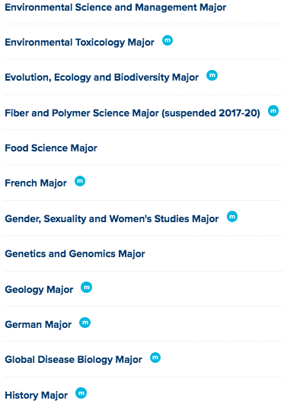
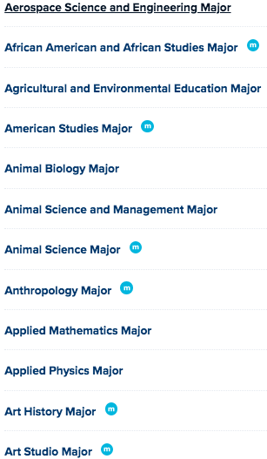
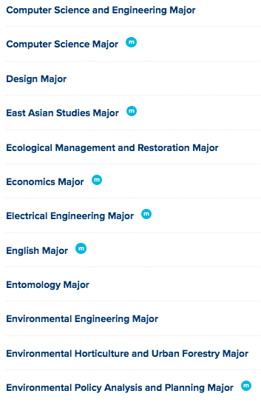
UC Davis Majors

Slide 3




Undergraduate Colleges

Slide 4
Questions:
What are the most common prerequisite lower-division courses at University of California, Davis for each undergraduate college?
What are the best 6 courses to take as a first-year undergraduate to minimize the chance of “wasted” units?
* “Best” defined as courses whose units are applicable to multiple majors within the same college.

Slide 5
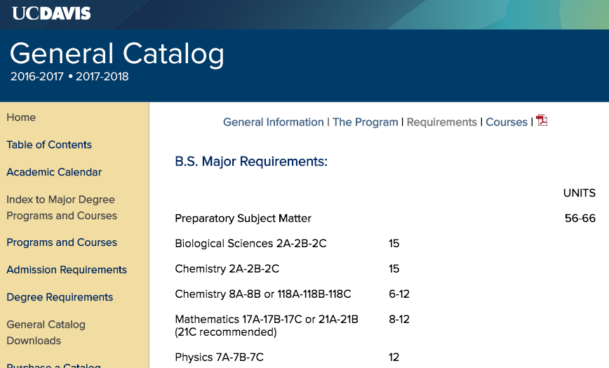
Determining Prerequisite Courses

Slide 6
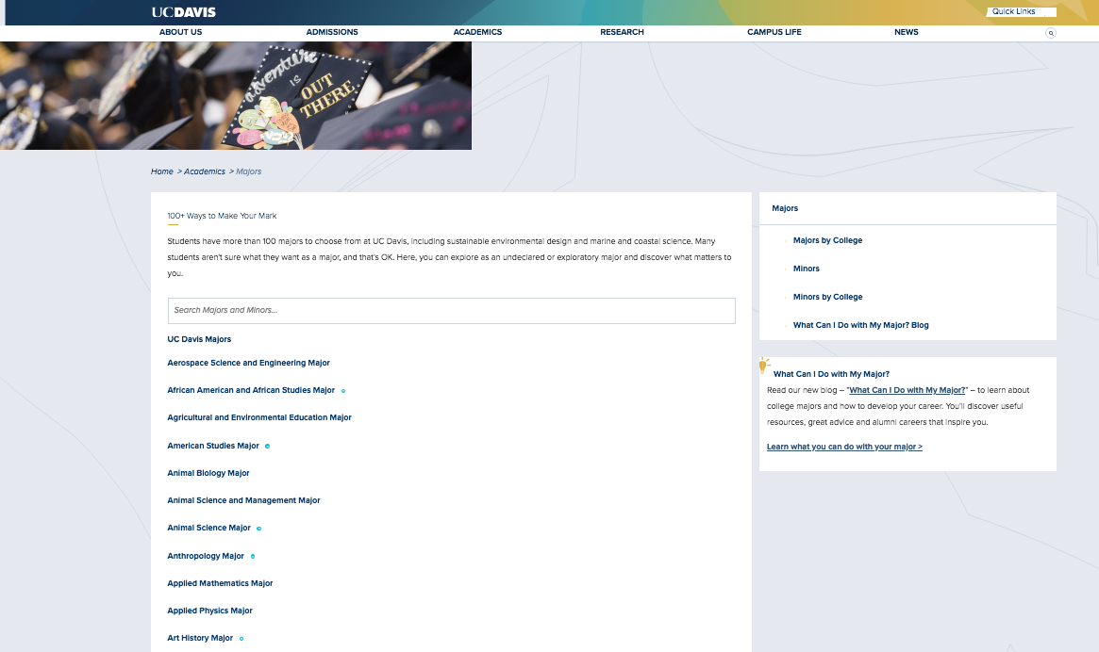

Slide 7
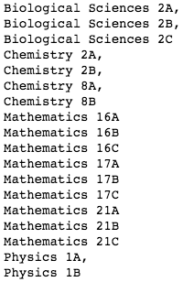
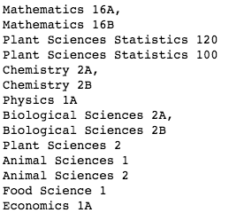
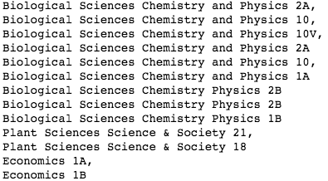
Prerequisite Courses Extracted

Slide 8
Next Steps
Data
Account for differences in formatting
Export data so that others can see it and perform their own analysis
Create visuals
Word clouds to see what subject areas are most commonly required prerequisites per college
Bar charts to quantitatively see how common each subject area is
Other visuals (TBD)

Slide 9
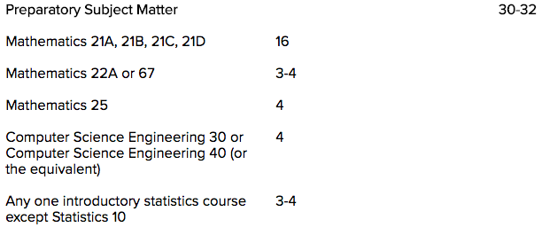
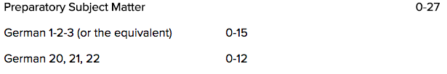
Potential Problems

Slide 10
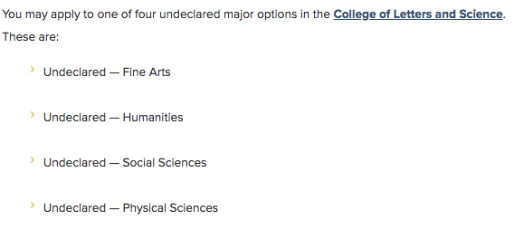
Potential Problems

